Slide 1
Python Session 7.2 – Regular Expressions

Slide 2
Regular Expressions
In computing, a regular expression, also referred to as "regex" or "regexp", provides a concise and flexible means for matching strings of text, such as particular characters, words, or patterns of characters. A regular expression is written in a formal language that can be interpreted by a regular expression processor.
Really clever "wild card" expressions for matching and parsing strings.
Regular expressions are a powerful string manipulation tool
All modern languages have similar library packages for regular expressions
Use regular expressions to:
Search a string (search and match)
Replace parts of a string (sub)
Break strings into smaller pieces (split)

Slide 3
Regular Expressions
Very powerful and quite cryptic
Fun once you understand them
Regular expressions are a language unto themselves
A language of "marker characters" - programming with characters
It is kind of an "old school" language - compact

Slide 4
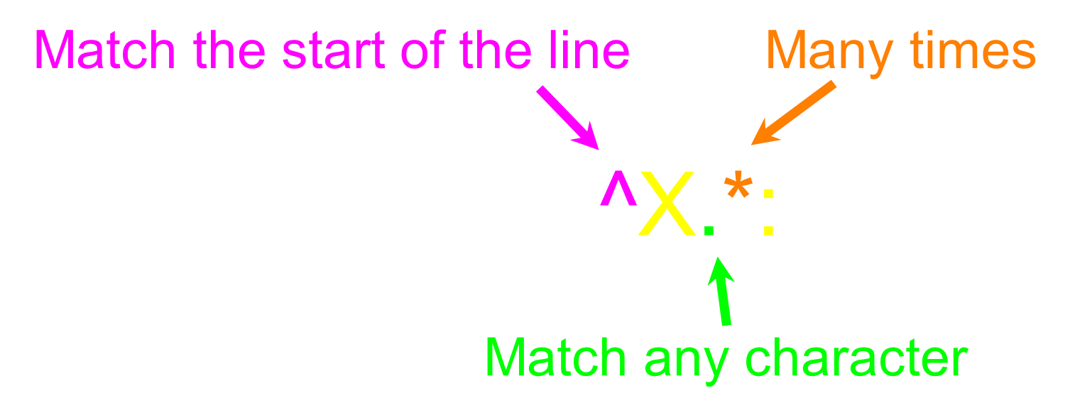
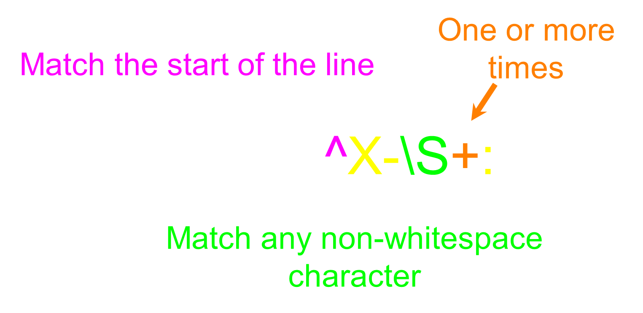
Regular Expression Quick Guide
^ Matches the beginning of a line
$ Matches the end of the line
. Matches any character
\s Matches whitespace
\S Matches any non-whitespace character
* Repeats a character zero or more times
*? Repeats a character zero or more times (non-greedy)
+ Repeats a character one or more times
+? Repeats a character one or more times (non-greedy)
[aeiou] Matches a single character in the listed set
[^XYZ] Matches a single character not in the listed set
[a-z0-9] The set of characters can include a range
( Indicates where string extraction is to start
) Indicates where string extraction is to end

Slide 5
The Regular Expression Module
Before you can use regular expressions in your program, you must import the library using "import re"
You can use re.search() to see if a string matches a regular expression similar to using the find() method for strings
You can use re.findall() extract portions of a string that match your regular expression similar to a combination of find() and slicing: var[5:10]
hand = open('mbox-short.txt')
for line in hand:
line = line.rstrip()
if line.find('From:') >= 0:
print line
hand = open('mbox-short.txt')
for line in hand:
line = line.rstrip()
if line.startswith('From:') :
print line
import re
hand = open('mbox-short.txt')
for line in hand:
line = line.rstrip()
if re.search('From:', line) :
print line
import re
hand = open('mbox-short.txt')
for line in hand:
line = line.rstrip()
if re.search('^From:', line) :
print line

Slide 6
Matching and Extracting Data
The re.search() returns a True/False depending on whether the string matches the regular expression
If we actually want the matching strings to be extracted, we use re.findall()
When we use re.findall() it returns a list of zero or more sub-strings that match the regular expression
>>> import re
>>> x = 'My 2 favorite numbers are 19 and 42'
>>> y = re.findall('[0-9]+',x)
>>> print y
['2', '19', '42']

Slide 7
Greedy Matching and Non-Greedy Matching
The repeat characters (* and +) push outward in both directions (greedy) to match the largest possible string
re.findall('^F.+:', x)
Not all regular expression repeat codes are greedy! If you add a ? character - the + and * chill out a bit...
re.findall('^F.+?:', x)

Slide 8
Search and Match
The two basic functions are re.search and re.match
Search looks for a pattern anywhere in a string
Match looks for a match staring at the beginning
Both return None (logical false) if the pattern isn’t found and a “match object” instance if it is
>>> import re
>>> pat = "a*b”
>>> re.search(pat,"fooaaabcde")
<_sre.SRE_Match object at 0x809c0>
>>> re.match(pat,"fooaaabcde")
>>>
>>> r1 = re.search("a*b","fooaaabcde")
>>> r1.group() # group returns string matched
'aaab'
>>> r1.start() # index of the match start
3
>>> r1.end() # index of the match end
7
>>> r1.span() # tuple of (start, end)
(3, 7)
>>> pat1 = "\w+@(\w+\.)+(com|org|net|edu)"
>>> r1 = re.match(pat,"finin@cs.umbc.edu")
>>> r1.group()
'finin@cs.umbc.edu’

Slide 9
We can put parentheses around groups we want to be able to reference
>>> pat2 = "(\w+)@((\w+\.)+(com|org|net|edu))"
>>> r2 = re.match(pat2,"finin@cs.umbc.edu")
>>> r2.group(1)
'finin'
>>> r2.group(2)
'cs.umbc.edu'
>>> r2.groups()
('finin', 'cs.umbc.edu', 'umbc.', 'edu’)

Slide 10
More re functions
re.split() is like split but can use patterns
>>> re.split("\W+", “This... is a test,
short and sweet, of split().”)
['This', 'is', 'a', 'test', 'short’,
'and', 'sweet', 'of', 'split’, ‘’]
re.sub substitutes one string for a pattern
>>> re.sub('(blue|white|red)', 'black', 'blue socks and red shoes')
'black socks and black shoes’
re.findall() finds al matches
>>> re.findall("\d+”,"12 dogs,11 cats, 1 egg")
['12', '11', ’1’]

Slide 11
Compiling regular expressions
If you plan to use a re pattern more than once, compile it to a re object
Python produces a special data structure that speeds up matching
>>> capt3 = re.compile(pat3)
>>> cpat3
<_sre.SRE_Pattern object at 0x2d9c0>
>>> r3 = cpat3.search("finin@cs.umbc.edu")
>>> r3
<_sre.SRE_Match object at 0x895a0>
>>> r3.group()
'finin@cs.umbc.edu'

Slide 12
Pattern object methods
Pattern objects have methods that parallel the re functions (e.g., match, search, split, findall, sub), e.g.:
>>> p1 = re.compile("\w+@\w+\.+com|org|net|edu")
>>> p1.match("steve@apple.com").group(0)
'steve@apple.com‘
>>> p1.search(”Email steve@apple.com today.").group(0)
'steve@apple.com’
>>> p1.findall("Email steve@apple.com and bill@msft.com now.")
['steve@apple.com', 'bill@msft.com']
>>> p2 = re.compile("[.?!]+\s+")
>>> p2.split("Tired? Go to bed! Now!! ")
['Tired', 'Go to bed', 'Now', ’ ']

Slide 13
Excercise
Find all numbers that include years, percentages, dollar amounts and other numeric figures in one regular expression.
Find all coated statements (i.e “statement”)
Count the number of paragraphs and number of words through regular expressions. Each word is only a set of alphabets (hint: see len(list) for counting)
Replace person’s name (i.e. Alan Spoon) with your name. You are not allowed to use “Alan Spoon” as a string to match. (hint: see re.sub() functionality to substitute string)
e.g: RE_space = re.compile(‘\s’)
sentence_without_space = RE_space.sub(‘’, sentence_with_space)
What strings are matched by the following regular expressions?
(a) [a-zA-Z]+
(b) [A-Z][a-z]+
(c) \w+|[^\w\s]

